Slide 1
New Master’s Program: Applied Statistics with Network Analysis
An Introduction
NRU HSE International Laboratory for Applied Network Research
http://anr.hse.ru

Slide 2
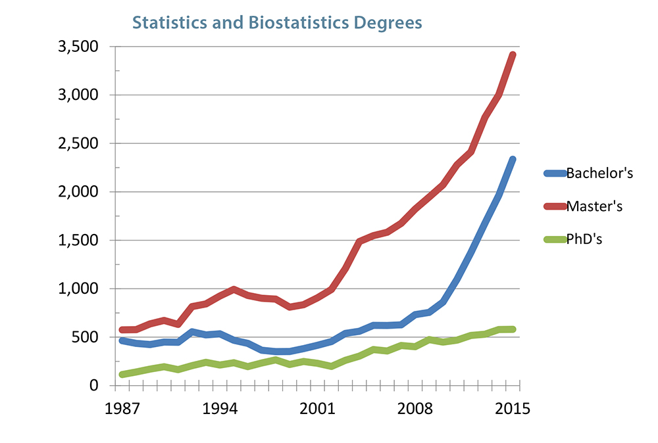
Why New Statistics Program?

Slide 3
Why Applied Statistics?
Statistical courses are usually caught in math or economics departments
They are limited to mathematical courses, formulas and derivations
Such analysis may not be applicable to other fields such as Psychology, Sociology, Economics, Education, Informatics, and Biology, where there is a strong need for data analysis
Without data, we can’t understand processes; without theory, we can’t understand data.
This program offers the best of both worlds

Slide 4
Career Tracks
Data analysts
Statistical consultants
Researchers in major consulting firms
Background for future PhD studies

Slide 5
Unique Features
This program is unique for Russia because it’s multidisciplinary
Other programs are targeted, e.g., at computer scientists (“big data” programs), or at specific fields (biology, medicine)
This program is rare in the world (applied programs are rare in general)
We offer both the theoretical foundation of interdisciplinary analysis and the deep understanding of statistical instruments
We offer advanced network analysis techniques

Slide 6
Unique features
We have world-renown faculty from best international universities
We are working with partnership with Northwestern University, USA and University of Ljubljana, Slovenia
We offer internship on the basis of our laboratory
Real-life projects, theoretical and applied
Consulting work for real clients

Slide 7
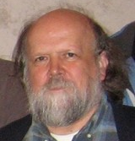
World-Renowned Faculty
Stan Wasserman
Programme Academic Supervisor
Academic Supervisor of the International laboratory for Applied Network Research
Vlado Batagelj
Professor of Discrete and Computational Mathematics, Department of Mathematics and Institute of Mathematics, Physics and Mechanics, Department for theoretical computer science, University of Ljubljana
Anushka Ferligoj Professor, Chair of Social Informatics and Methodology, Centre for Methodology and Informatics, Faculty of Socail Sciences, University of Ljubljana
Douglas Steinley,
Professor, Psycological Sciences, University of Missouri

Slide 8
Quick facts
Full-time (but evening education) Master’s Program
2 years of study
Very competitive cost (relative to other world programs)
Language of study: English
Entrance requirements: Portfolio (English language test, bachelor’s degree in any field)

Slide 9
Individual Program Tracks
Applied Statistics (no networks)
Networks track
Individual study plans to account for background
Stronger math backgrounds are offered more courses in theory development
Stronger applied backgrounds are offered more mathematical courses

Slide 10
Sample courses
Contemporary Data Analysis: Methodology of Interdisciplinary Research
Contemporary Decision Sciences Methods: an Integrated Perspective
Statistical Learning Theory
Nonparametric Theory and Data Analysis
Applied Linear Models
Network Analysis with R
Advanced Topics in Network Analysis

Slide 11
Thank you!
For any questions, please email anr@hse.ru

